Slide 1
Teach Yourself Modelling in R
Capital One

Slide 2
No false hopes
Only in commercials
Deo’s get you dates
trainings make you pros
This is not a commercial.
This is more like a survivors handbook to modelling in R. So, you will not
Be a pro in statistical modelling
Be a pro in R
Be a pro in anything for that matter

Slide 3
At the end, you will learn to
Read R code
Help yourself get your job done in R
Perform common tasks in building statistical models

Slide 4
We expect the audience
Is familiar with some programming language
Has built statistical models
Is familiar with basic banking paradigms
Has R and RStudio installed in their systems

Slide 5
The coding commandments
RTFM ?whatIwant2know
STFW Google/StackOverFlow/StatExchange
KISS Useful for Pipes and Filters

Slide 6
Before we start, we should know that
R is an interpreted, object oriented language
Everything (variable, functions etc) in R is an object
Vectors & Matrices contain same type of data
Lists & Data Frame may contain heterogeneous data
You execute R statements, one at a time, by entering them at the R prompt in the console window.
In R Studio, you can press Ctrl+Enter in the editor to execute a line/selection
‘nuff said. Let’s code
Notes:
Every object has attributes one of which is class
Objects are containers that hold data and functions

Slide 7
We will need to
Import data to R
Treat data
Univariate analysis
Bivariate analysis
Build model
Variable selection
Performance and Residual analysis
Read from external file
Rearrange for convenience
The codes are available at this location.
For executing a line of code, press Ctrl+enter
We encourage you to follow along

Slide 8
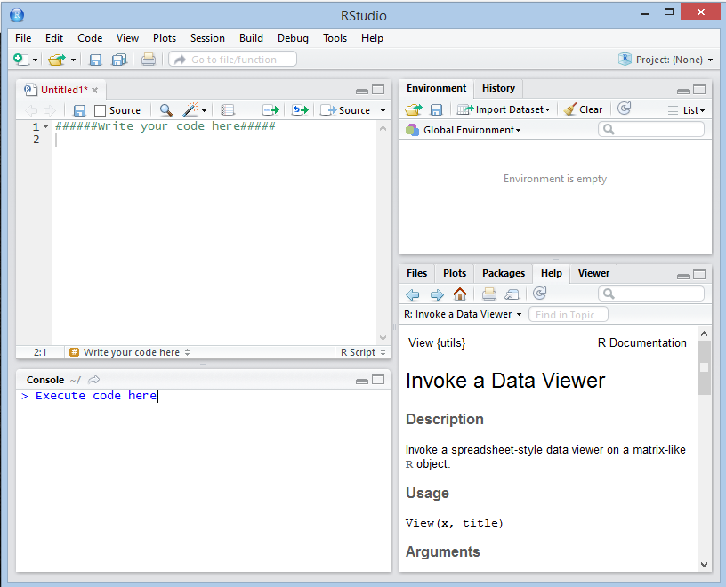
Open RStudio
1
3
Editor – Write your code here
Console – execute code, one line at a time
Environment – User defined R Objects appear here
Viewer – Shows for help, graphs etc
2
4

